Slide 1
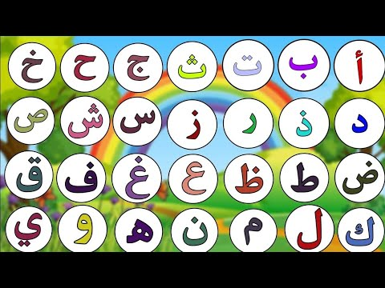
Revision
Arabic family has 28 letters.
.Read Arabic from right to left

Slide 2
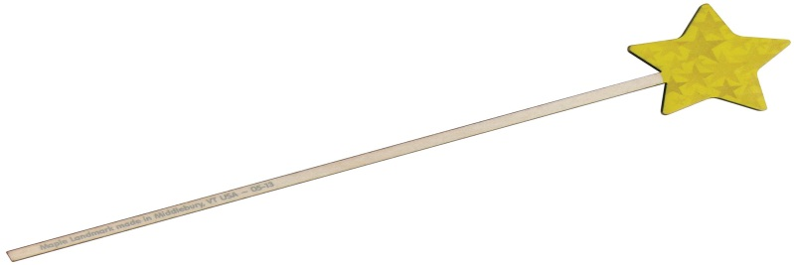
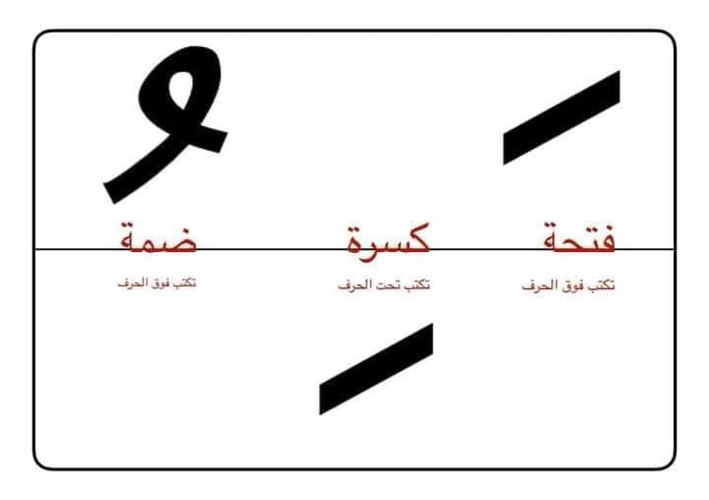
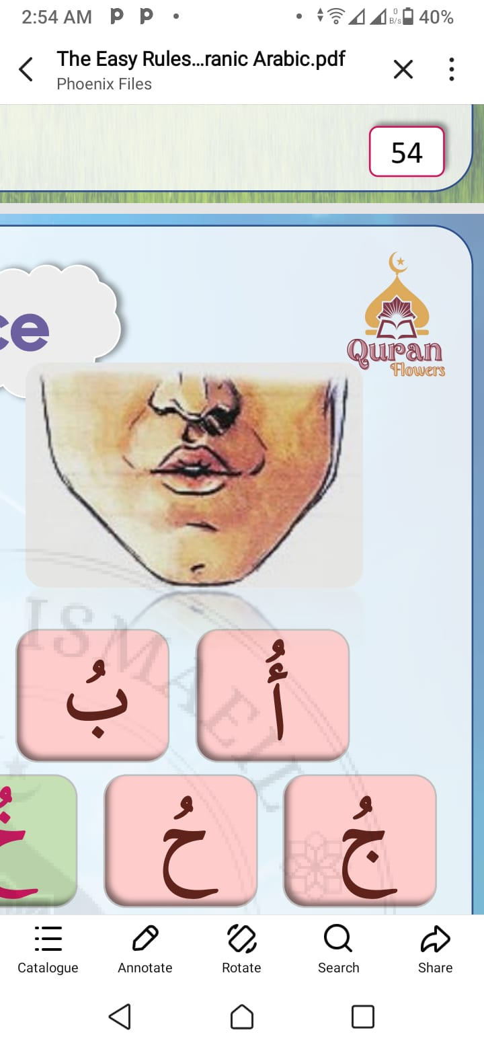
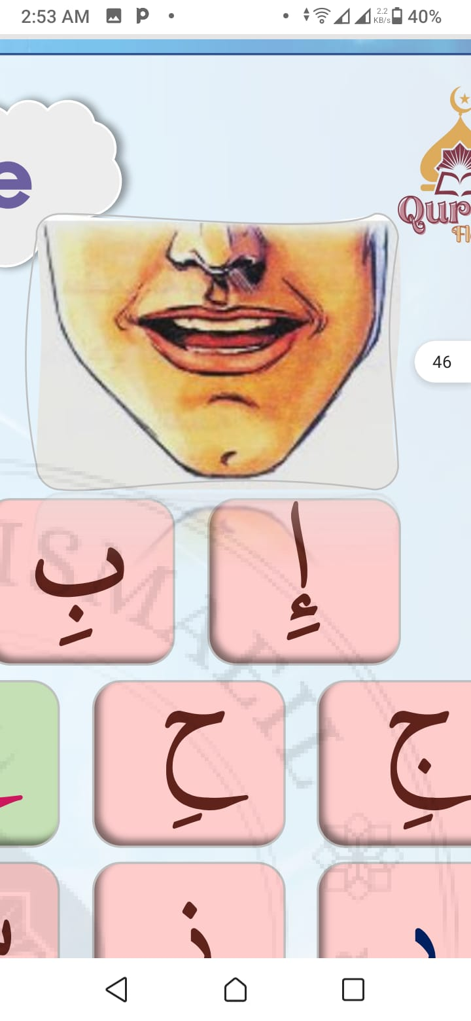
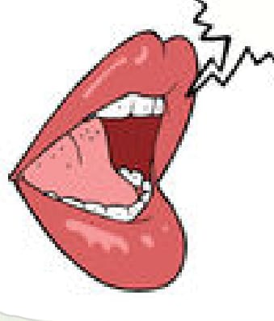
SHORT VOWLES
Dumma
kasra
Fatha

Slide 3

play now

Slide 4
Long vowels ( Madd ) ( ا – و – ى )
Fatha follwed by free alif alif madd
Kasra followed by free yaa yaa madd
dummah followed by free waw waw madd
سَ | سَا | سَاءَ
بِ | بِى | خَبِير
حُ | حُو | حُوت

Slide 5
play now

